Slide 1

iSupport Platform
For your daily care
Team members:
Burdisso Sara s275424
Centonze Ilenia s277389
Ferrara Mauro s276932
Pasotti Andrea s275100
Notes:
Welcome to iSupport Platform
iSupport platform aims to help in monitoring patients (peiscens) in a depressed state or suspected ones.

Slide 2

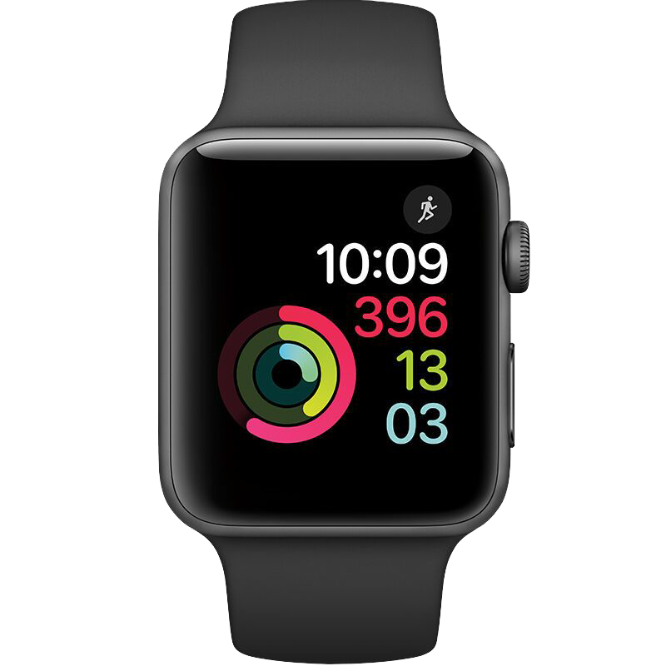

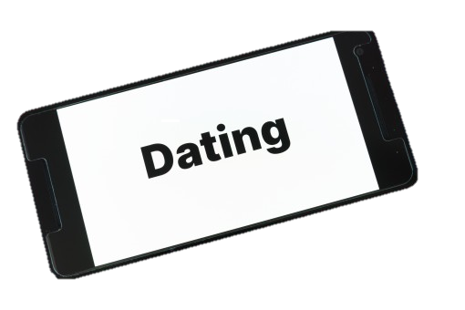

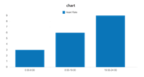
The idea - overview
Recording and analyzing data from sensors
Emergency management
Remote Patient Monitoring
Objective:
To help clinicians and caregivers follow individuals in depressive states during their treatment period by providing a remote monitoring and support platform.

Slide 3
Protocolli di Comunicazione
REST Web Service
It allows to synchronize the communication between the parties.
Catalog: accesses the system information present in a JSON file and communicates it to the other actors;
ThingSpeak: database with data coming from the sensors. The data is accessed with a GET request and provided via a message in JSON format.
MQTT
Lightweight and flexible protocol suitable for ioT applications.
Publish messages in JSON format using QoS 2
Receive messages using QoS 2
Message topic: hierarchical, containing patient information

Slide 4
Use Case Diagram - proposal
Microservices
ThingSpeak platform
ThingSpeak Adaptor
Patient Control
Data Analysis
Light Shift
Home System Control
Node-RED
Message Broker
Device Connector
Telegram Bot
User Awareness
Legend:
Catalog
MQTT Communication
REST Web Services (provider)
REST Web Services (consumer)

Slide 5
Use Case Diagram - modified
Microservices
ThingSpeak platform
Patient Control
Data Analysis
ThingSpeak Adaptor
Light Shift
Home System Control
Telegram Bot
Message Broker
Device Connector
Node-RED
User Awareness
Legend:
Catalog
MQTT Communication
REST Web Services (provider)
REST Web Services (consumer)

Slide 6

Catalog
It communicates with all the other actors in the platform exploiting REST communication.
{
"Catalog_url":"http://127.0.0.1:8080",
"baseTopic":"iSupport/",
" LightShift ":{
"clientID" : "LigthShiftMS",
"endTopic":[" actuators/Light"]
},
...

Slide 7
Catalog
{
"broker": {
"IPaddress": "test.mosquitto.org",
"port": 1883
},
"token": "1711013176:AAH6bCdvA0dOdL8fX4FIfCPGEqpEFNjN1d4",
"deviceList": [
{
"deviceName": "smartwatch_1",
"deviceID": "1",
"measureType": [
"HeartRate",
"Accelerometer"
],
"availableServices": [
"MQTT"
],
"servicesDetails": [
{
"serviceType": "MQTT",
"topic": [
"iSupport/1/sensors/Body"
]
}
],
"lastUpdate": 1621764472.704841
}],
"patientList": [
{
"patientID": "1",
"patientName": "Mario",
"patientSurname": "Rossi",
"LightsSchedule": "7:30-8:30",
"connectedDevices": [
{
"measure": [
"Heart Rate",
"Acceration"
],
"deviceID": "smartwatch_1"
},
"telegramIDs": [1234567],
"thingspeakInfo": {
"apikeys": [
"ZQ2AJZABDSC4MXXG",
"SV1HOET58CE7225M"
],
"channel": 1342741
},
"lastUpdate": 1622981412.5148401
}
]
}
Catalog.json contains information about general configuration, registered devices and registered patients.

Slide 8
Catalog
IP/broker
IP/token
It communicates with all the other actors in the platform exploiting REST communication.
It has 3 main functions:
Retrieve (GET)
Add (POST)
Update (PUT)
IP/patients
GET
IP/devices
IP/deviceID/ID
IP/patientID/ID

Slide 9
Catalog
IP/chatID/ID
Body={
"chatID": 1234567,
}
It communicates with all the other actors in the platform exploiting REST communication.
It has 3 main functions :
Retrieve (GET)
Add (POST)
Update (PUT)
POST
IP/patient
Body={
"patientID": "2",
"patientName": "Francesco",
"patientSurname": "Bianchi",
"LightsSchedule": "17:00-18:30"
}
Body={
"deviceName": "mot_1",
"deviceID": "3",
"measureType": [
"Motion"
],
"availableServices": [
"MQTT"
],
"servicesDetails": [
{
"serviceType": "MQTT",
"topic": [
"iSupport/1/sensors/Motion"
]
}
]
}
IP/device

Slide 10
Catalog
Body={
"patientID": «1",
"patientName": "Francesco",
"patientSurname": "Bianchi",
"LightsSchedule": "17:00-18:30",
"connectedDevices": [
{
"measure": "Temperature",
"deviceID": "t_1"
}
],
"telegramIDs": [],
"thingspeakInfo": {
"apikeys": [
"ZQ2AJZABDSC4MXXG",
"SV1HOET58CE7225M"
],
"channel": 1342741
},
"lastUpdate": ""
}
It communicates with all the other actors in the platform exploiting REST communication.
It has 3 main functions:
Retrieve (GET)
Add (POST)
Update (PUT)
IP/patient
PUT
Body={
"deviceName": "smartwatch_1",
"deviceID": "1",
"measureType": [
"HeartRate",
"Accelerometer"
],
"availableServices": [
"MQTT"
],
"servicesDetails": [
{
"serviceType": "MQTT",
"topic": [
"iSupport/1/sensors/Body"
]
}
],
"lastUpdate": 1623097970.3872042
}
IP/device

Slide 11
Catalog
Start
Check all «LastUpdate»
Catalog keeps updated the “deviceList” with the devices correctly connected and removes all the devices that are disconnected.
No
«LastUpdate» >120 s
Yes
"deviceList": [
{
"deviceName": "smartwatch_1",
"deviceID": "1",
"measureType": [
"HeartRate",
"Accelerometer"
],
"availableServices": [
"MQTT"
],
"servicesDetails": [
{
"serviceType": "MQTT",
"topic": [
"iSupport/1/sensors/Body"
]
}
],
"lastUpdate": 1621764472.704841
}]
Delete the device from «DeviceList»
Wait for 60 seconds

Slide 12
Device Connector
Temperature and Humidity:
Extraction of a value from uniform distributions that have specific limits that change according to the month in which publication occurs. User sets mode of generation:
in the suitable range
out of range
Motion Sensor:
It is a value (1/0) set by the user
Devices implemented in the simulation:
- Temperature and humidity sensors
Morion Sensor
Heart rate sensor
Accelerometer sensor
Actuator for air Conditionair system
Smart light bulb actuator

Slide 13
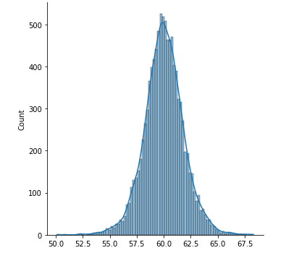
Device Connector
-HR and Accelerometer measurments:
Accelerometer measurments are obtained from 2 database: REST.txt and SPORT.txt
REST configuration
Devices implemented in the simulation:
- Temperature and humidity sensors
Motion Sensor
Heart rate sensor
Accelerometer sensor
Actuator for air Conditionair system
Smart light bulb actuator
HR
REST.txt
0.06275
0.04957
0.11802
0.28902
0.10596
0.556840…
+
bpm

Slide 14
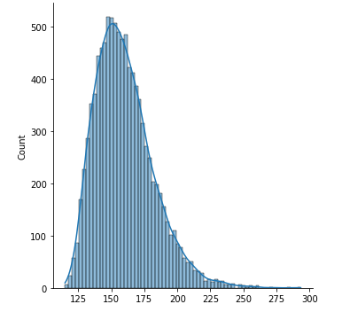
Device Connector
-HR and Accelerometer measurments:
Accelerometer measurments are obtained from 2 database: REST.txt and SPORT.txt
Sport configuration
Devices implemented in the simulation:
- Temperature and humidity sensors
Motion Sensor
Heart rate sensor
Accelerometer sensor
Actuator for air Conditionair system
Smart light bulb actuator
HR
SPORT.txt
6.920512
7.049275
7.176033
7.291157
7.398414
8.597905
8.611896…
+
bpm

Slide 15
Device Connector
-HR and Accelerometer measurments:
Accelerometer measurments are obtained from 2 database: REST.txt and SPORT.txt
«Danger» configuration
Devices implemented in the simulation:
- Temperature and humidity sensors
Motion Sensor
Heart rate sensor
Accelerometer sensor
Actuator for air Conditionair system
Smart light bulb actuator
HR
REST.txt
0.06275
0.04957
0.11802
0.28902
0.10596
0.556840…
+
bpm

Slide 16
Device Connector
Actuation Commands:
Switching on the air Conditionair system to maintain optimal temperature and humidity levels.
Switching on smart lights to enable luminotherapy.
Devices implemented in the simulation:
- Temperature and humidity sensors
Presence Sensor
Heart rate sensor
Accelerometer sensor
Actuator for air Conditionair system
Smart light bulb actuator

Slide 17
Device Connector
Communication with
Communication with the other actors is done using SenML format.
Catalog: to register devices or refresh registration with a REST communication.
ThingSpeak Adaptor: which receives all measurements from the sensors published by Device Connector.
Home system Control: device connector publishes sensor measurements to this microservice, which sends actuation commands to switch on and off the temperature control system.
Light Shift: from which device connector receives actuation command to switch on/off smart light bulbs for luminotherapy.
self.__message={
"bn": 1,
"e": [{
"n": "Heart Rate",
"value": 61,
"timestamp": "123456",
"u": "bpm"
},
{
"n": "Accelerometer",
"value": 0.060369,
"timestamp": "123456",
"u": "m/s2"
}
]
}

Slide 18
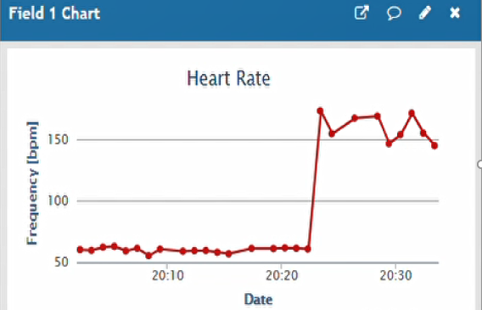
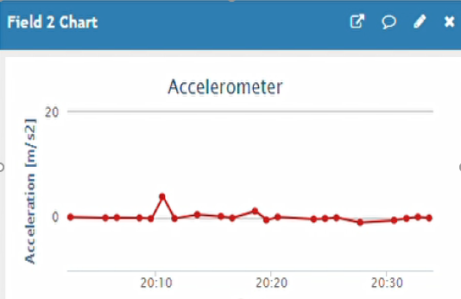
Patient Control
Goal: Monitoring the patient and detecting of panic attack
How it works
Communication with
Analyze heart rate and acceleration data
ThingSpeak: for getting measurement of 10 minutes windows.

Slide 19
Patient Control
How it works
Communication with
Analyze heart rate and acceleration data
Communicate an alert in case of panic attack to the doctor and caregiver
ThingSpeak: for getting measurement of 10 minutes windows.
ThingSpeak: for recording the panic attack event
Telegram bot: for communicating the panic attack event

Slide 20
Home system Control
Goal: Monitoring home for having a comfortable enviroment
How it works
Manages temperature and humidity inside the house
Verifies patient presence in the home
Avoid wasting energy by establishing activation time slots
Start
Receives data from sensors
Control Strategy every 10 minutes

Slide 21
Home system Control
Start
How it works
Receives data from sensors
Manages temperature and humidity inside the house
Verifies patient presence in the home
Avoid wasting energy by establishing activation time slots
Control Strategy every 10 minutes
Presence + time slots
Temperature out of range
Yes
Yes
No
Air Conditioning System
ON
Check Temperature and Humidity window
No
Humidity out of range
Yes
No
Air Conditioning System
OFF

Slide 22
Home system Control
How it works
Communication with
Manages temperature and humidity inside the house
Verifies patient presence in the home
Avoid wasting energy by establishing activation time slots
Device connector:
Continuously receives data from Temperature and Humidity sensors
Sends actuation commands if it is identified a condition to switch ON or OFF the Air Conditioning System

Slide 23


Light Shift
How it works
Communication with
Manages the lighting system in relation to the physician's established schedule for luminotherapy
Catalog:
to obtain the times in which to activate the luminotherapy
Device Connectors:
to send actuations commands to turn the lights ON or OFF

Slide 24
ThingSpeak
It’s a platform used like a database in which there are all measurement got from different sensors implemented on iSupport platform
It uses an adaptor ThingSpeak Adaptor which:
Allows you to implement communication via MQTT.
Increases the scalability of the platform
Increases interoperability between components.

Slide 25
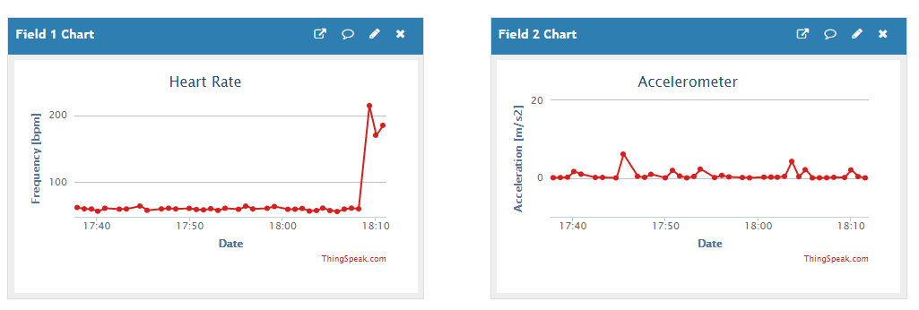
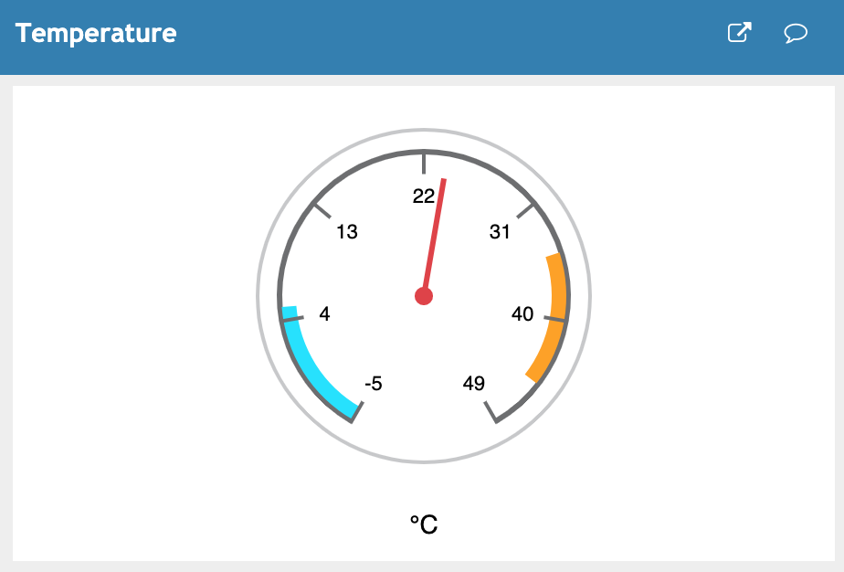
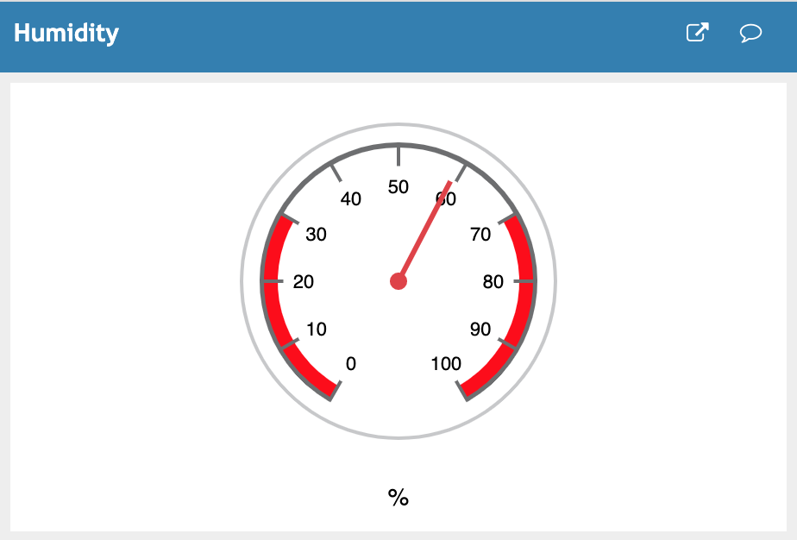
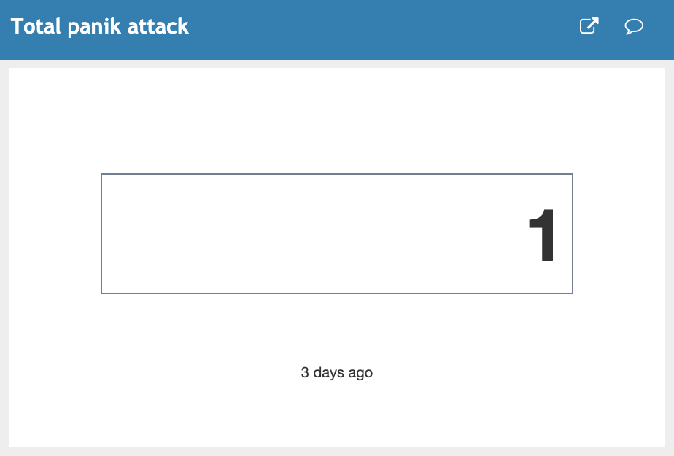
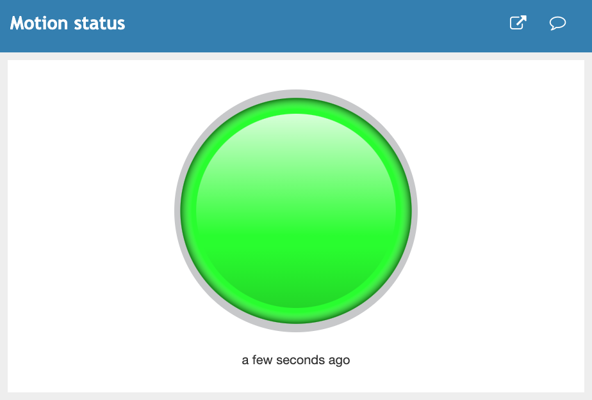
ThingSpeak third part Application User Interface

Slide 26
ThingSpeak
Communication with
It’s a platform used like a database in which there are all measurement got from different sensors implemented on iSupport platform
It uses an adaptor ThingSpeak Adaptor which:
Allows you to implement communication via MQTT.
Increases the scalability of the platform
Increases interoperability between components.
Device Connector: continous updating of measurements
Data Analysis: sending measurements received from the device connector.
Patient Control: sending measurements related to specific observation windows.

Slide 27
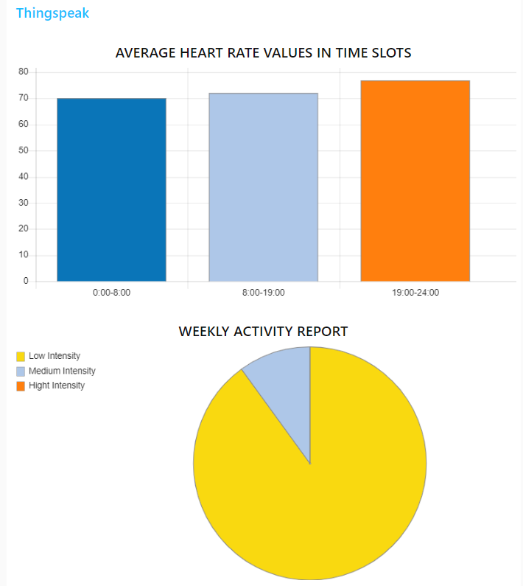
Data Analysis
How it works
Communication with
Process patient measurements to get weekly or monthly statistics:
Weekly report about average heart rate in 3 time bands.
Weekly report about patient’s activity status (percentage of low, medium, high intensity obtained as comparing rate and acceleration measurements
Number of monthly panic attacks
Weekly report about how much time patient spends in the bedroom (level of sedentary lifestyle)
ThingSpeak Adaptor: to get measurements
Node-RED: to create statistical graphs
Node-RED interface

Slide 28
Data Analysis
How it works
Communication with
Process patient measurements to get weekly or monthly statistics:
Weekly report about average frequency values in 3 time bands.
Weekly report about patient’s activity status (percentage of low, medium, high intensity obtained as comparing rate and acceleration measurements.
Number of monthly panic attacks.
Weekly report about how much time patient spends in the bedroom (level of sedentary lifestyle).
ThingSpeak Adaptor: to get measurements
Node-RED: to create statistical graphs
Node-RED interface

Slide 29
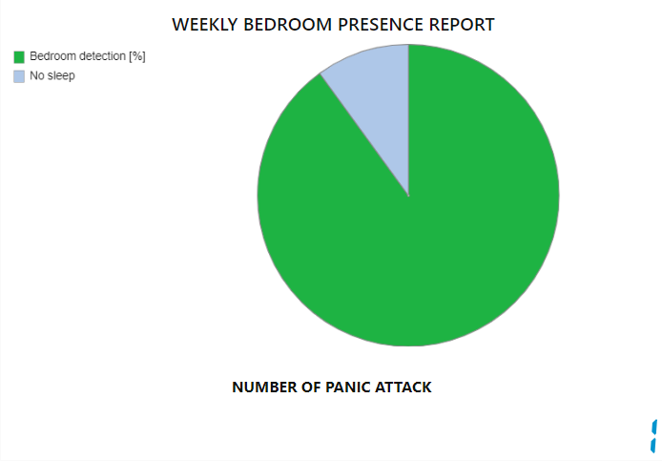
Data Analysis
How it works
Communication with
Process patient measurements to get weekly or monthly statistics:
Weekly report about average frequency values in 3 time bands.
Weekly report about patient’s activity status (percentage of low, medium, high intensity obtained as comparing rate and acceleration measurements.
Number of monthly panic attacks.
Weekly report about how much time patient spends in the bedroom (level of sedentary lifestyle).
ThingSpeak Adaptor: to get measurements
Node-RED: to create statistical graphs
Node-RED interface

Slide 30
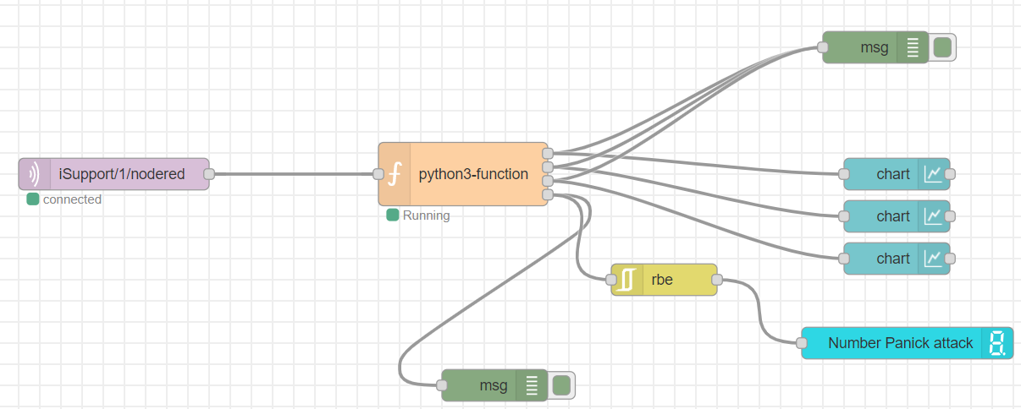
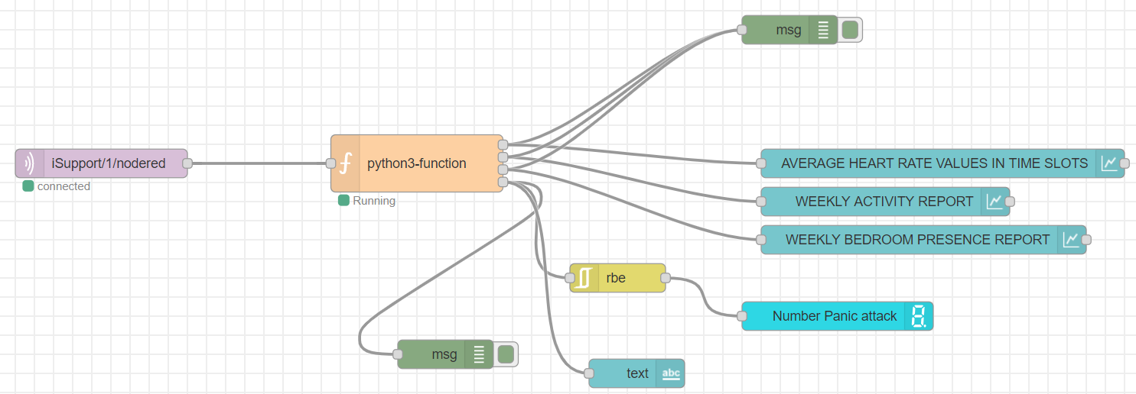
Node-RED
How it works
Nodes:
MQTT communication node
Python function
Two blocks to visualize msg.payload in debug display
A rbe block
A digital display and three chart

Slide 31
Telegram Bot
‘/start’ function:
Telegram user registration on platform
‘/status’ function:
Visualization of ThingSpeak graphs about vital signs
Emergency management:
Getting alert message from the Patient Control microservice in case of Panic Attack.
Emergency management
Allow the doctor and the caregiver to always be updated on the Heart Rate, Movement and Recurrence trends of panic attacks.

Slide 32
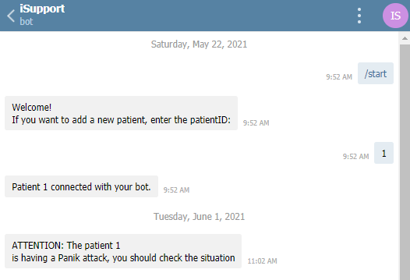
Telegram Bot
‘/start’ function:
Telegram user registration on platform
Emergency management
Allow the doctor and the caregiver to always be updated on the Heart Rate, Movement and Recurrence trends of panic attacks.
Notes:
Collega la chatID del medico e caregiver al paziente

Slide 33
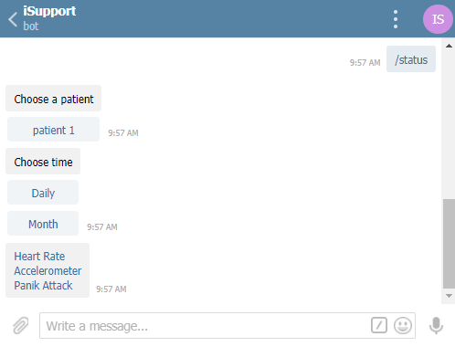
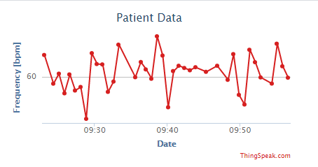
Telegram Bot
‘/status’ function:
Visualization of ThingSpeak graphs about vital signs
Emergency management
Allow the doctor and the caregiver to always be updated on the Heart Rate, Movement and Recurrence trends of panic attacks.

Slide 34
Telegram Bot
Emergency management:
Getting alert message from the Patient Control microservice in case of Panic Attack.
Emergency management
Allow the doctor and the caregiver to always be updated on the Heart Rate, Movement and Recurrence trends of panic attacks.

Slide 35
Telegram Bot
Communication with
Emergency management
Allow the doctor and the caregiver to always be updated on the Heart Rate, Movement and Recurrence trends of panic attacks.
Patient Control: which publishes a message to the telegram bot if it detects a panic attack
ThingSpeak: required for viewing graphs
Catalog: retrieve chatId and token

Slide 36
Thanks for your attention
Team 3:
Burdisso Sara s275424
Centonze Ilenia s277389
Ferrara Mauro s276932
Pasotti Andrea s275100

